Slide 1
Responsible Gold Mining Principles
Briefing for Assurance Providers
July 23 and July 27/28 2020

Slide 2
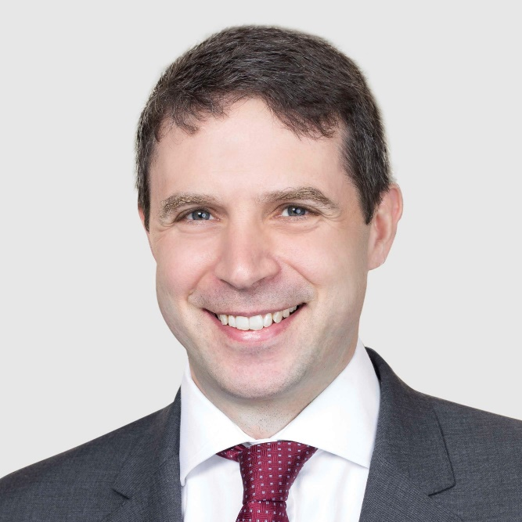



Speakers
Terry Heymann
Chief Financial Officer
Edward Bickham
Senior Advisor
Peter Sinclair
Senior Advisor
Notes:
To change headshot pictures…
>Right click on picture to change
>Format Picture
>Fill & Line (the paint bucket symbol)
>File (select the picture you require)
If picture needs adjusting in the circle..
>Click on picture
>Picture tools (from top menu)
>Crop
>Fill
Drag picture to fit correctly in circle

Slide 3


Instructions
Please stay on mute unless speaking
Submit written questions anytime
Use the ‘raise your hand’ feature to ask a verbal question at the end of the presentation
Session is being recorded and
will be posted for future viewing

Slide 4
Agenda
Introductions
RGMP overview
Assurance framework overview
Key features of assurance
Common questions answered
Equivalency
Q+A

Slide 5
World Gold Council
SPDR Gold Shares (GLD®)
Launched first Gold-backed ETF in the US in partnership with State Street Global Advisors
  Supporting the Gold market
  Leading industry authority on Gold for over 30 years
  Proven track record for strengthening market infrastructure, delivering robust data and insights and developing solutions to expand access to Gold globally
  Deep relationships with the institutional investor ecosystem, central banks, sovereign wealth funds and industry participants
China Market Expansion
Played key role in evolution of the Shanghai Gold Exchange; currently working towards enabling insurance companies to invest in Gold
India Blueprint
Led steering committee comprised of financial institutions and industry and trade associations in the development of a blueprint for a proposed Gold Spot Exchange
Responsible Gold Mining Principles
Worked with mining company members, developed a framework setting out expectations for consumers, investors and the downstream Gold supply chain as to what constitutes responsible Gold mining
Gold Valuation Framework
Developed an academically endorsed methodology to help investors understand how macroeconomic scenarios might impact Gold demand, supply and long-term performance
Data
Analytics
Research
Market
knowledge
Policies
Infrastructure

Slide 6

























World Gold Council members
26 companies; 500+ projects; 100+ productive mines; operations in 45+ countries

Slide 7
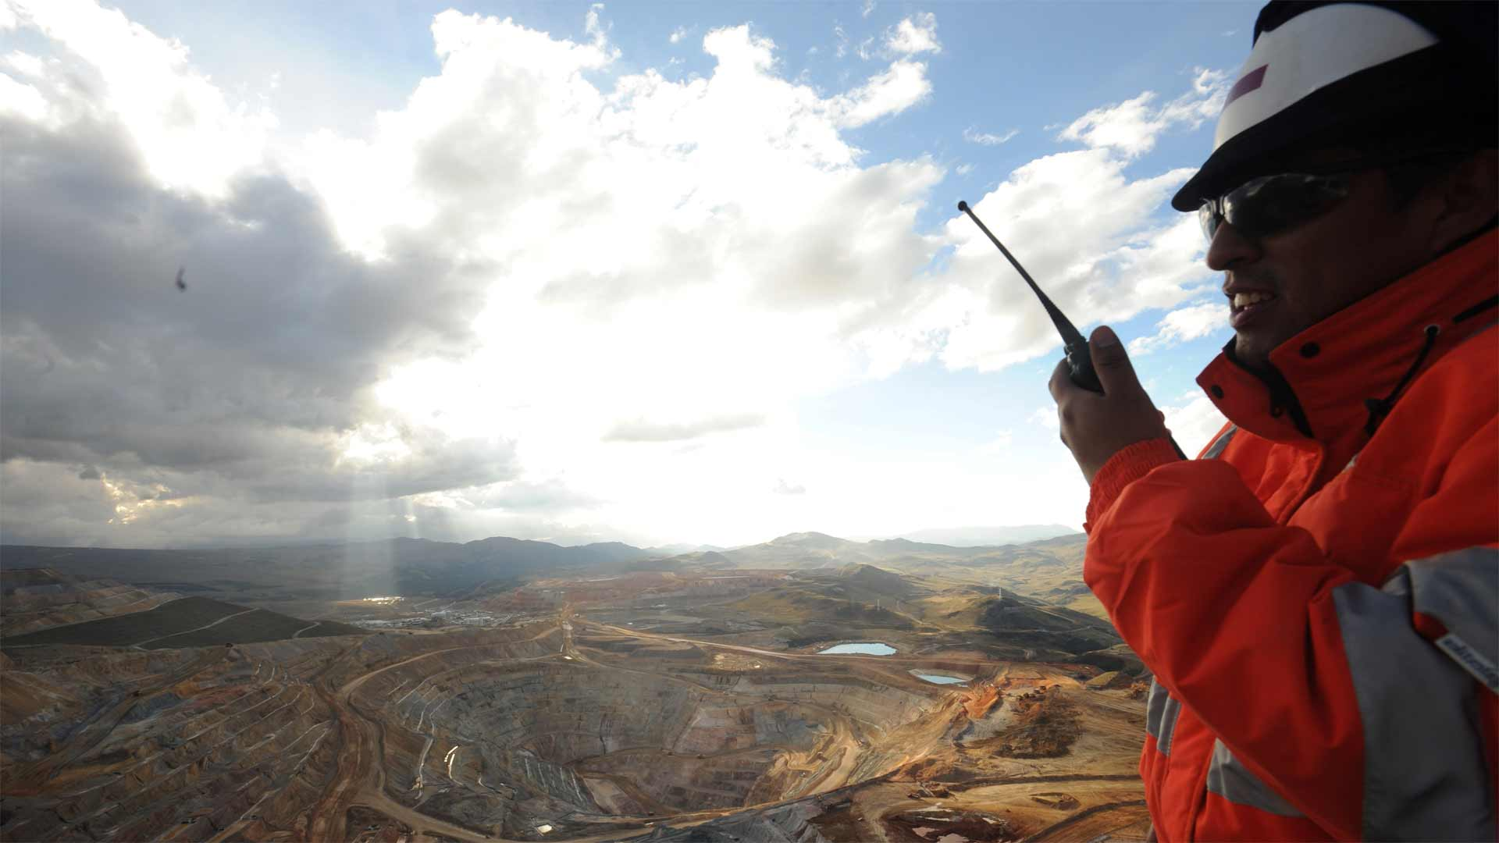


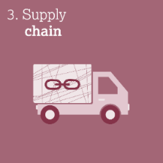





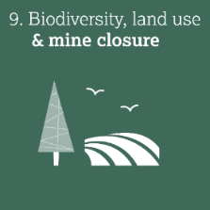

Responsible Gold Mining Principles
A framework which reflects expectations of responsible Gold mining.
Provides investor and consumer confidence that their Gold is ethically sourced.
Developed with strong input from civil society, investors, governments and supply chain participants.
Conformance requires full public disclosure and independent assurance.
Reflects the commitment of the world’s leading gold mining companies.
  Image courtesy of
Newmont Mining, Yanacocha, Peru

Slide 8
Context for the development of the RGMPs
A single framework of best practice across the full spectrum of ESG topics
  Integrate key tenets of well-established and reputable international standards/frameworks (e.g. VPSHRs, UNGPs)
  Include gold-specific issues such as cyanide management, mercury, ASM
Facilitate LBMA due diligence requirements (Responsible Gold Guidance V8)
Minimize audit burden for members with multiple memberships
  Avoid a “virtue contest” with other leading industry frameworks
Available to the entire gold mining industry

Slide 9
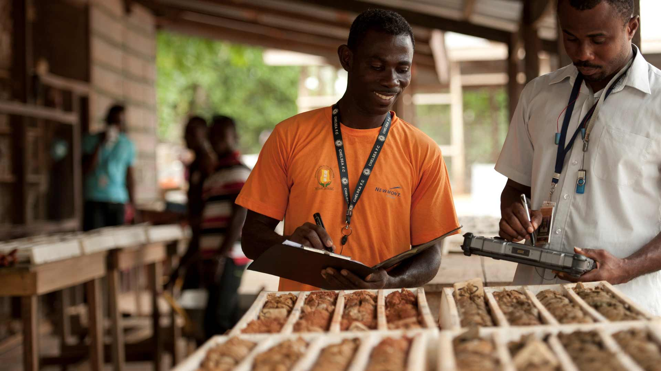
Consultation during development during RGMPs
        Two rounds of consultation on draft RGMPs in 2018 and 2019.
        Online questionnaires and direct outreach to stakeholders.
        Independently hosted multi-stakeholder roundtables
        Input received from c.300 individuals and institutions:
        Governments and international organisations
        Investors and ESG ratings agencies
        Mining companies (and associations) and
        gold supply chain participants
        NGOs, think tanks and academics
        Community groups (in South Africa)
Image courtesy of Newmont Mining, Akyem mine, Ghana

Slide 10

The Principles
10 umbrella Principles; 51 Principles
Governance
  Ethical conduct
  Understanding our impacts
  Supply chain
Environment
  Environmental stewardship
  Biodiversity, land use & mine closure
  Water, energy & climate change
Social
  Safety & health
  Human rights & conflict
  Labour rights
  Working with communities

Slide 11
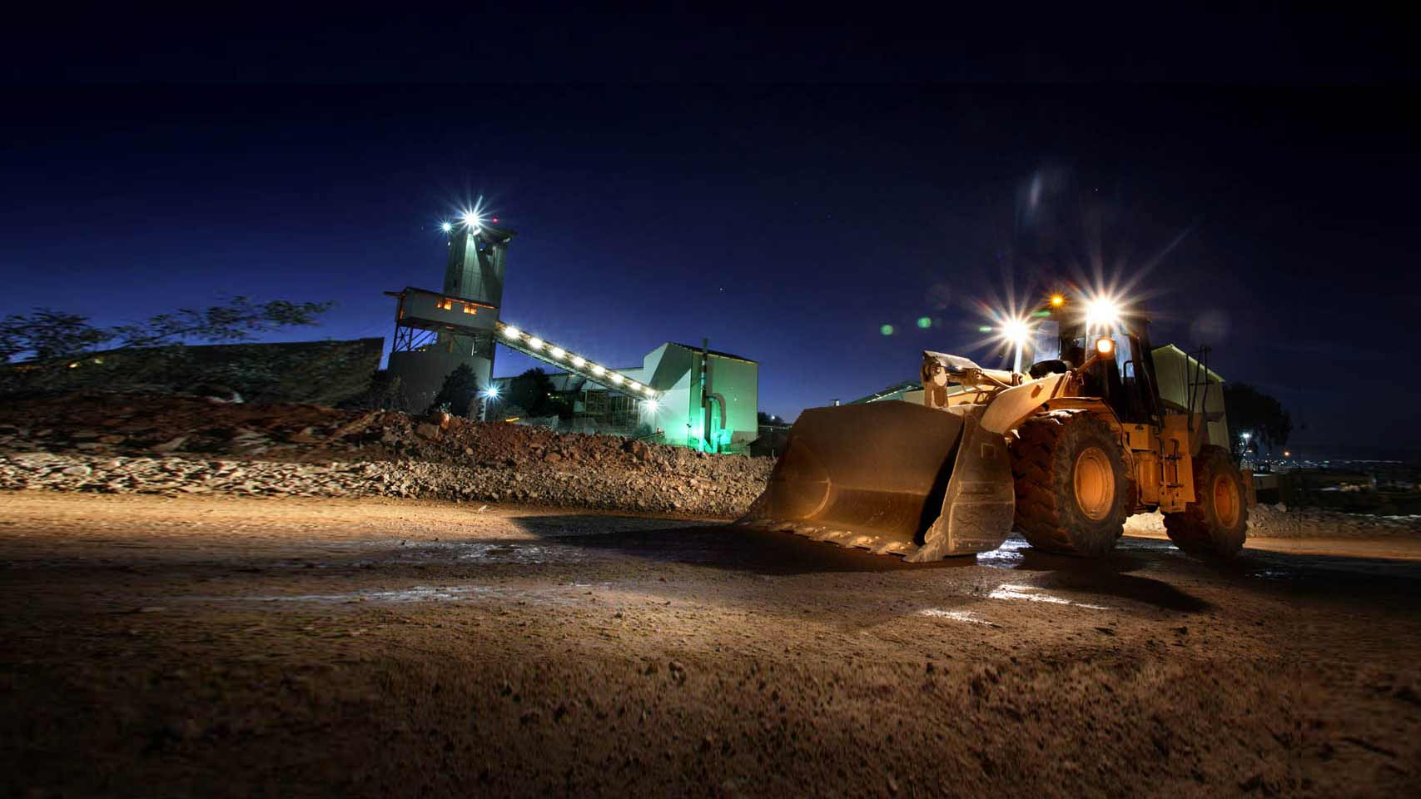
Principle 1
Ethical Conduct
We will conduct our business with integrity including absolute opposition to corruption.
Supporting Principles covering:
    Legal compliance
    Code of Conduct
    Combatting Corruption
    Transparency
    Taxes and Transfer Pricing
    Internal Accountabilities and Reporting
  Image courtesy of
Newmont mining, Tanami, Australia

Slide 12

Principle 2
Understanding our Impacts
We will engage with our stakeholders and implement management systems so as to ensure that we assess, understand and manage our impacts, realise opportunities and provide remedy where needed.
Supporting Principles covering:
    Risk Management
    Stakeholder Engagement
    Due Diligence
    Impact Assessment
    Handling Grievances

Slide 13
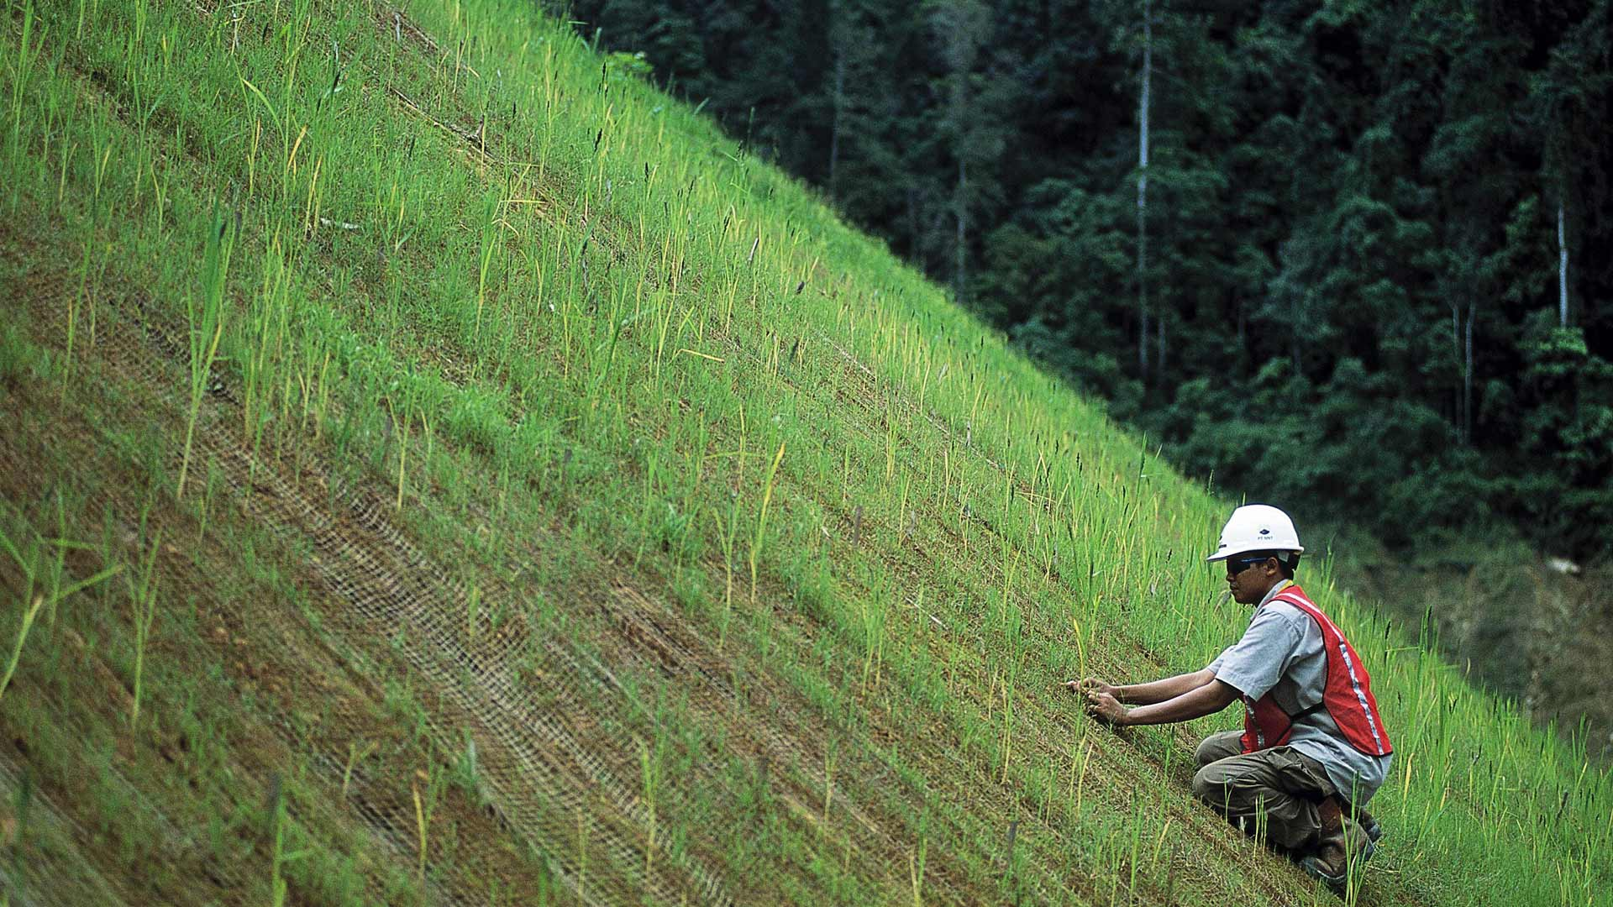
Principle 3
Supply Chain
We will require that our suppliers conduct their businesses ethically and responsibly as a condition of doing business with us.
Supporting Principles covering:
    Supply Chain Policy
    Local Procurement
    Market Access for ASM

Slide 14
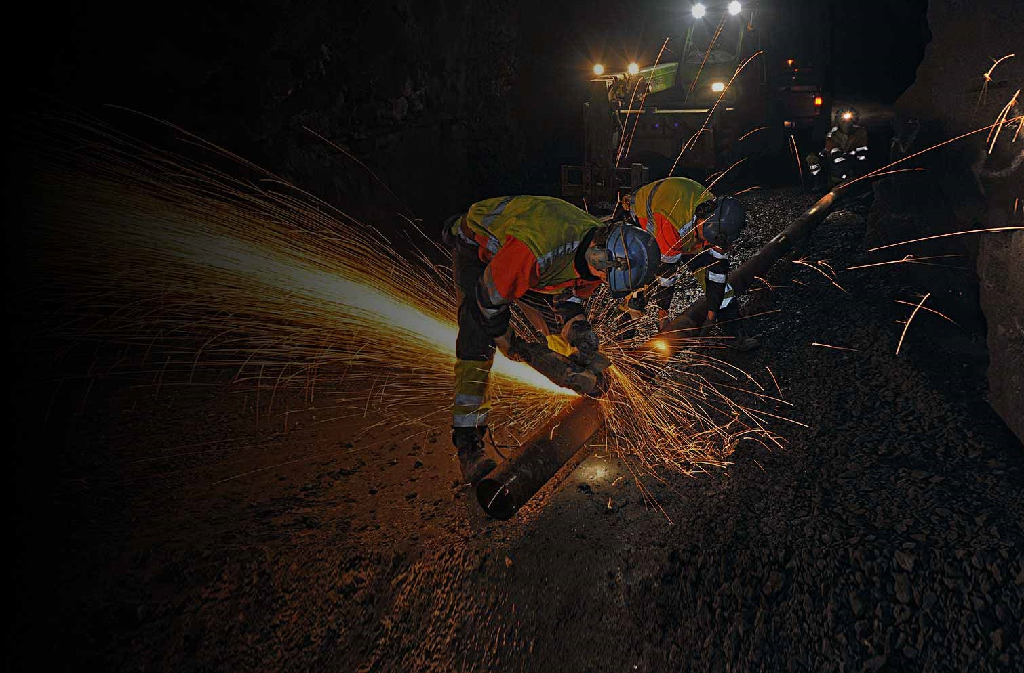
Principle 4
Safety and Health
We will protect and promote the safety and occupational health of our workforce (employees and contractors) above all other priorities and will empower them to speak-up if they encounter unsafe working conditions.
Supporting Principles covering:
    Safety Goal
    Safety Management Systems
    Occupational Health and Wellbeing
    Community Health and Emergency Planning

Slide 15

Principle 5
Human Rights and Conflict
We will respect the human rights of our workforce, affected communities and all those people with whom we interact.
Supporting Principles covering:
    UN Guiding Principles on Business and Human Rights
    Avoiding Complicity
    Security and Human Rights
    Conflict-Free Gold
  Image courtesy of
Unsplash

Slide 16

Principle 6
Labour Rights
We will ensure that our operations are places where employees and contractors are treated with respect and are free from discrimination or abusive labour practices.
Supporting Principles covering:
    Wages and Benefits
    Preventing Discrimination and Bullying
    Child and Forced Labour
    Freedom of Association and Collective Bargaining
    Diversity
    Women and Mining
    Raising Concerns
  Image courtesy of
Miners at AngloGold Ashanti’s Obuasi mine, Ghana

Slide 17

Principle 7
Working with Communities
We will contribute to the socio-economic advancement of communities associated with our operations and treat them with dignity and respect.
Supporting Principles covering:
    Consultation
    Understanding Communities
    Creating Local Benefits
    Seeking Community Support
    In-Migration
    Indigenous Peoples
    Cultural Heritage
    Resettlement
  Image courtesy of
Unsplash

Slide 18
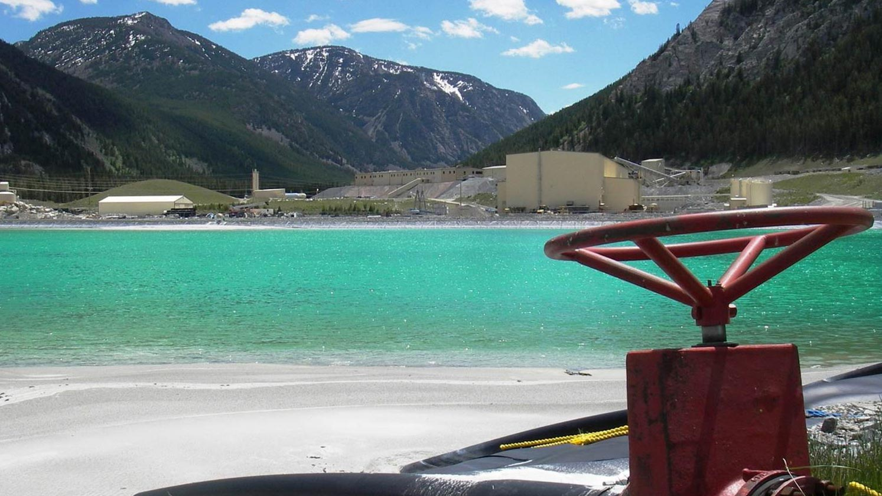
Principle 8
Environmental Stewardship
We will ensure that environmental responsibility is at the core of how we work.
Supporting Principles covering:
    Managing Environmental Impacts
    Tailings and Waste Management
    Cyanide and Hazardous Materials
    Mercury
    Noise, Dust, Vibration and Blasting
  Image courtesy of
Sibanye Gold, Stillwater Mine

Slide 19
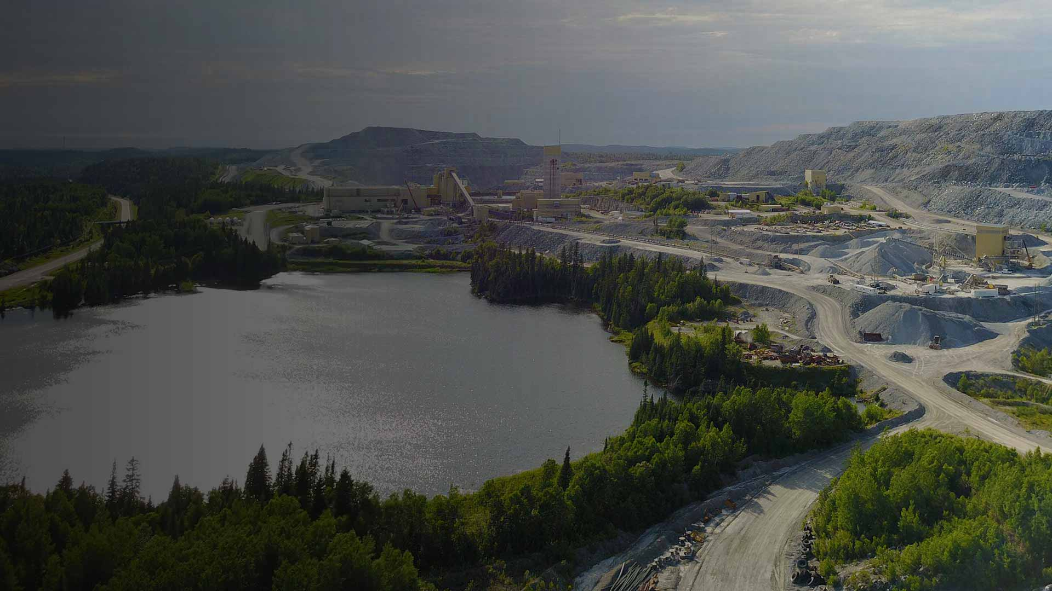
Principle 9
Biodiversity, Land Use and Mine Closure
We will work to ensure that fragile ecosystems, habitats and endangered species are protected from damage, and will plan for responsible mine closure.
Supporting Principles covering:
    Biodiversity
    World Heritage Sites
    Land Use and Deforestation
    Mine Closure
  Image courtesy of
Barrick Hemlo mine

Slide 20
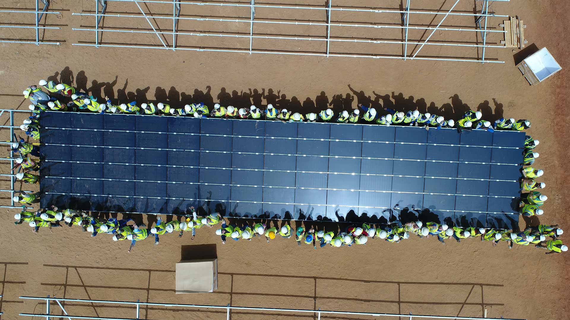
Principle 10
Water, Energy and Climate Change
We will improve the efficiency of our use of water and energy, recognising that the impacts of climate change and water constraints may increasingly become a threat to the locations where we work and a risk to our license to operate.
Supporting Principles covering:
    Water Efficiency
    Water Access and Quality
    Combating Climate Change
    Energy Efficiency and Reporting
  Image courtesy of
Solar Plant, EssaKane

Slide 21
RGMP Implementing Company Requirements
Make a public commitment to align with the RGMPs (Year 1)
Develop internal systems and processes to conform with the RGMPs
Produce an annual report describing the company’s conformance
Obtain independent assurance on the company’s conformance, annually

Slide 22
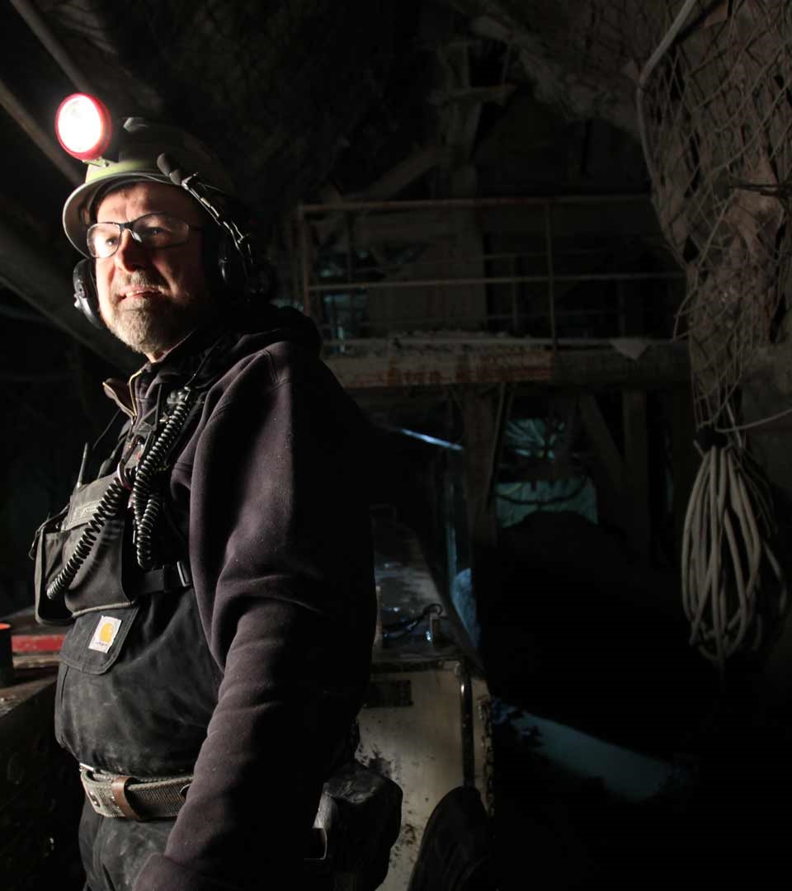
Development of the Assurance Framework
Key considerations
  Opportunity to integrate assurance with other reporting and assurance activities.
  Avoid being too prescriptive while maintaining credibility of the assurance process.
  Reflect consultation, including with assurance providers.
  Rely on professional advice for the Assurance Framework
  Pilot test assurance process - two companies, including site visits - Centerra’s Kumtor Mine in Kyrgyzstan & Sibanye-Stillwater’s Kluff Mine in South Africa
Image courtesy of Sibanye Gold, East Boulder

Slide 23
Assurance
Key Features
Standards
  Provider must use a globally recognised assurance standard (e.g. ISAE3000)
  No specific standard prescribed
  Limited level of assurance expected
Credentials of assurance provider
  Competent, independent
  Likely a multidisciplinary team (e.g. 2-3 experts), mining experience critical
  Assurance provider is selected by the company
  WGC does not plan to certify or approve assurance providers

Slide 24
Assurance
Key Features (con’t)
Assurance coverage/scope
  All gold mining/processing operations over which a company has direct control
  Corporate, regional/national, site level assurance required
  Some RGMPs may be deemed ‘not applicable’
  Materiality considerations should be applied
  Reporting
  Annually
  RGMP Report produced by the implementing company (could be integrated into Sustainability Report)
  Independent Assurance Report produced by the assurance provider
  Basic reporting templates included in the Assurance Framework Guide

Slide 25
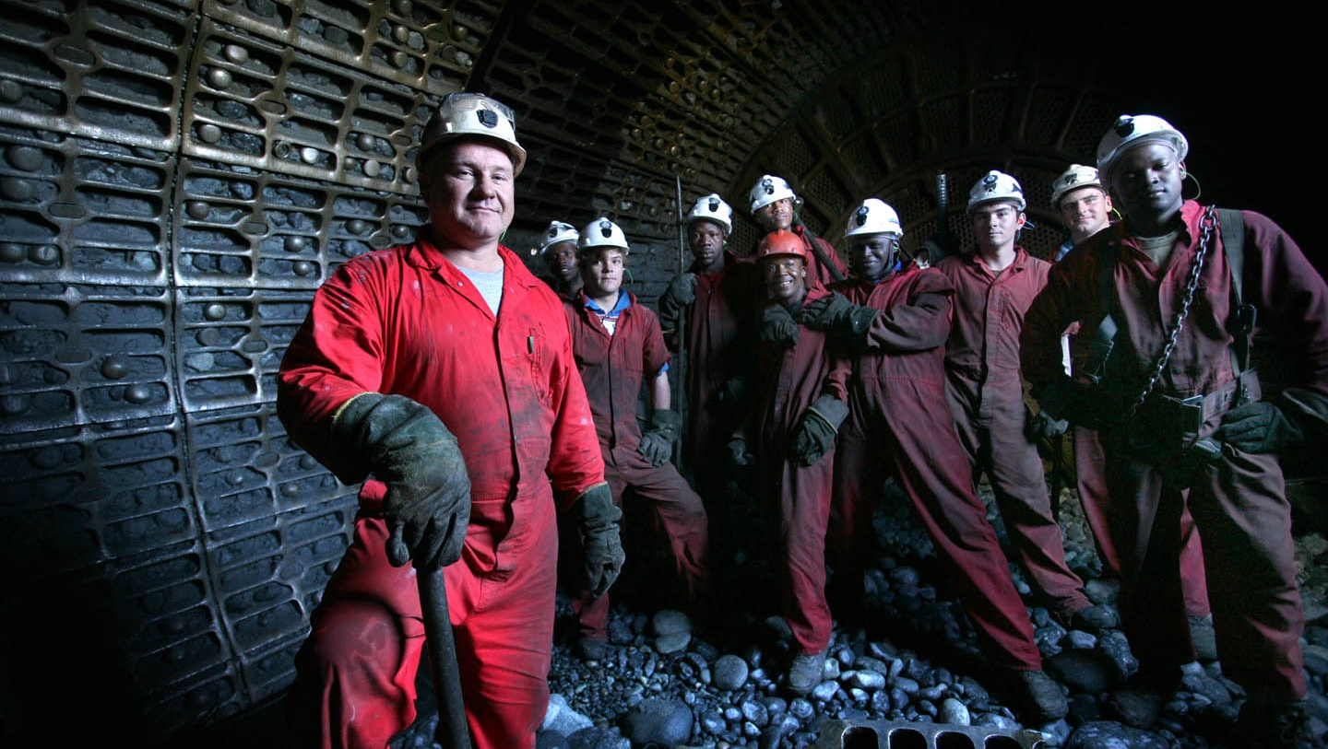
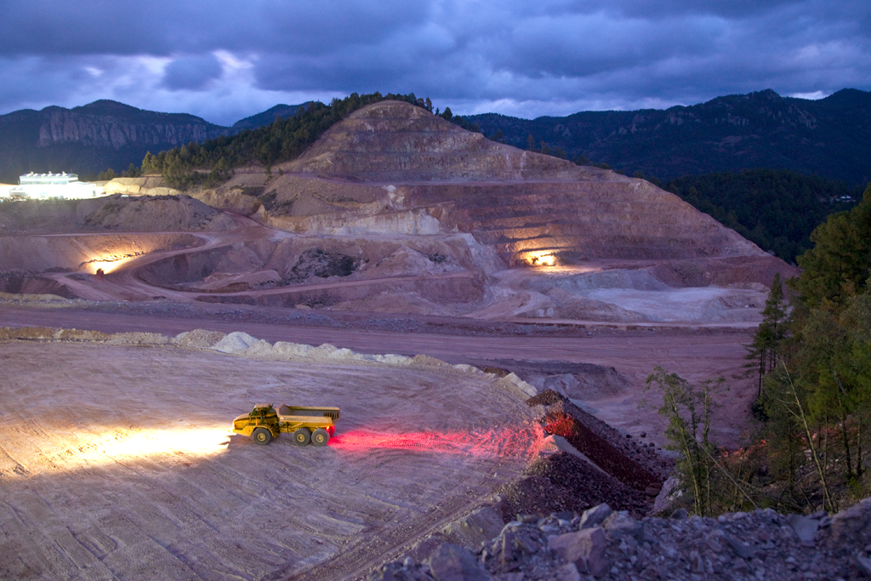
Timing
Ramp up phase
Minimum requirements
          Year 1
  Public commitment to the RGMPs,
  report on the process of initiating self-assessment, obtain assurance
          Year 2
  Report on progress of self-assessment,
  obtain assurance
          Year 3+
  Full conformance (by Sept 2022),
  RGMP Report, obtain assurance
  RGMPs were launched in Sept 2019
  Image courtesy of
Sibanye Gold, Beatrix Operations

Slide 26


Areas of non-conformance and implications for assurance
Credible reporting and assurance requires disclosure of non-conformances:
  No non-conformances in year 1 and 2 as long as basic requirements are met, i.e. commitment and self-assessment.
  From year 3 the company must disclose any non-conformances, including incidents, in a transparent, fair and balanced manner.
  Non-conformances will be referenced by the assurance provider in their conclusion.
  Provider will use their judgement to decide whether they can still deliver a statement of assurance if non-conformances exist
  Adequate action plans and commitment to timely conformance for non-material RGMPs may not result in overall non-conformance.

Slide 27
Common Questions Answered
    Guide for implementation and assurance: List of criteria is not mandatory, assurance conducted on the Principles, not the guidance.
    Site visits: 1-4 sites per year, cycling through all sites in 3-5 years. Not required in year 1 & 2.
    Site prioritisation: Use a materiality assessment to determine which sites should be visited first, in collaboration with assurance provider.
    No requirement to apply RGMPs retrospectively.
    Non-operational assets: assurance not required, but companies are expected to apply RGMPs to the extent they can, especially in project development phase.
    Streaming companies – use their influence to encourage adoption of the RGMPs, only required to assure assets in which they have operational control.

Slide 28
Equivalency Tables
  For other frameworks also implemented by WGC members - ICMMs Mining Principles, Mining Association of Canada’s Towards Sustainable Mining.
  Tables articulate where the requirements from one framework overlap sufficiently with another for them to be considered “equivalent”, that is, if one requirement is met the other related requirement is automatically met.
  Threshold for determining equivalency: the scope and intent (and therefore likely outcomes) of the two requirements are the same, even if there are differences in the detail of the requirements and the language used.
  Highlight where there are legitimate gaps between the requirements of the two frameworks, or where one is silent on a particular issue covered by the other.
  Facilitate the assurance of both frameworks at the same time
        Status
  Draft tables currently under review, once finalised intention is to publicly disclose
  WGC members have access to the draft equivalency tables

Slide 29
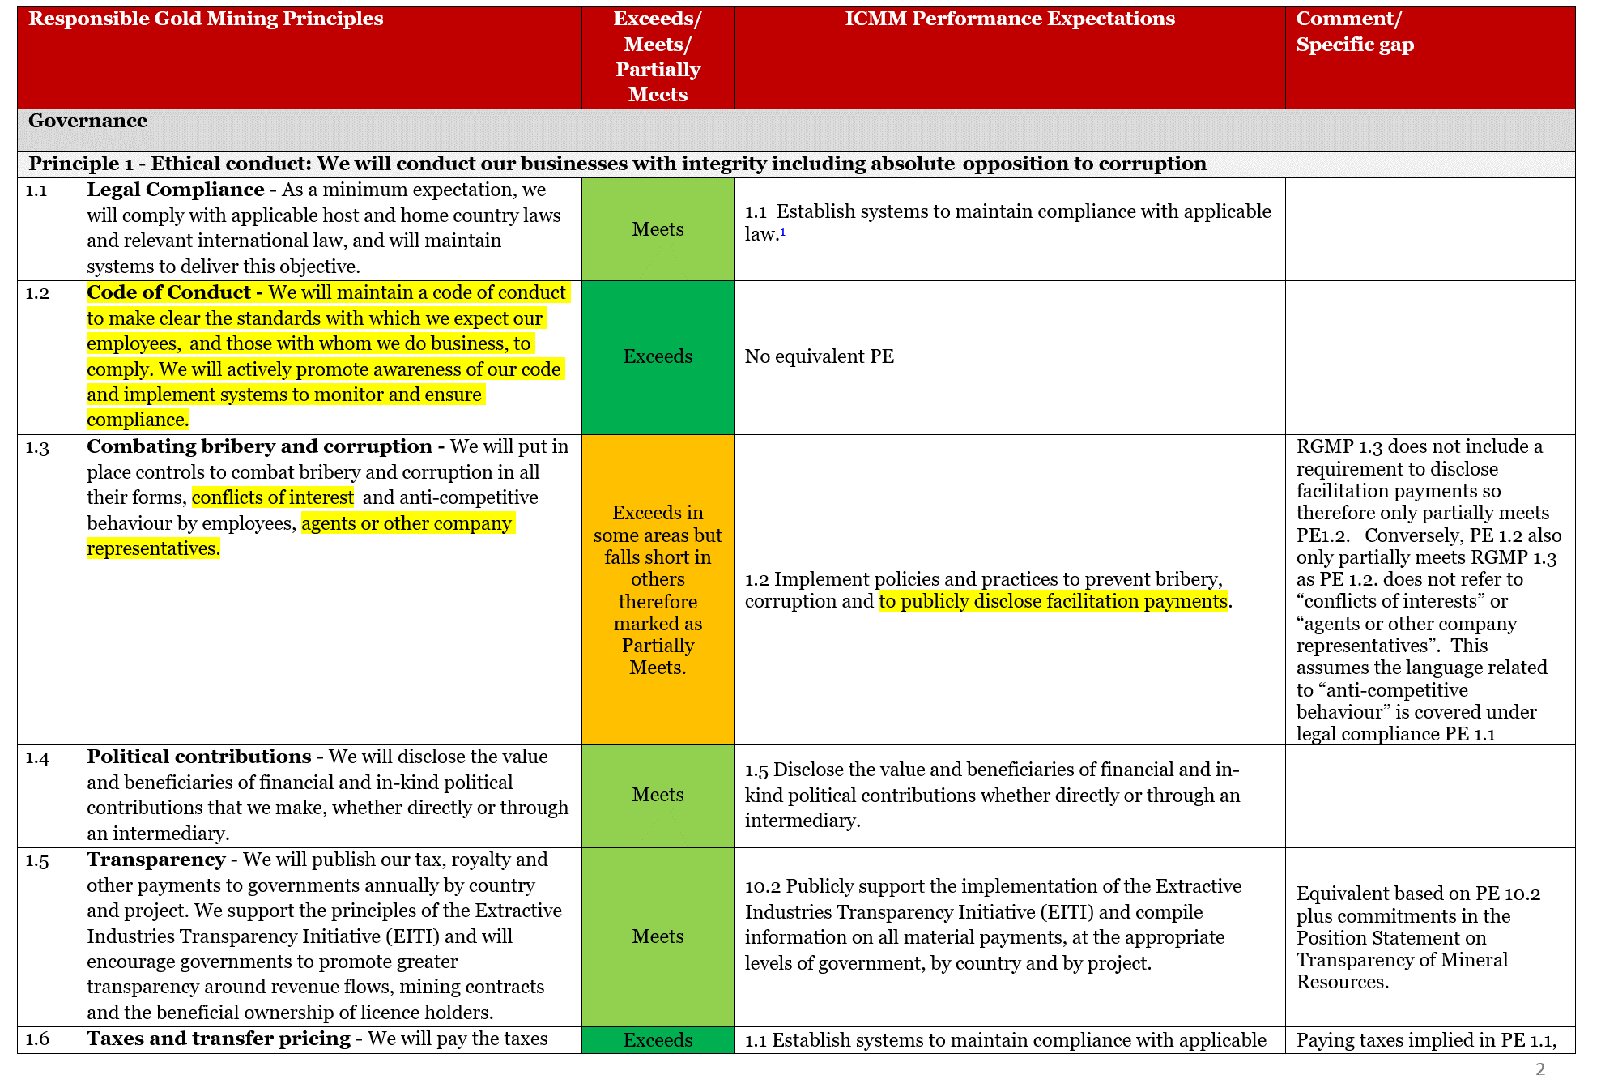
DRAFT

Slide 30
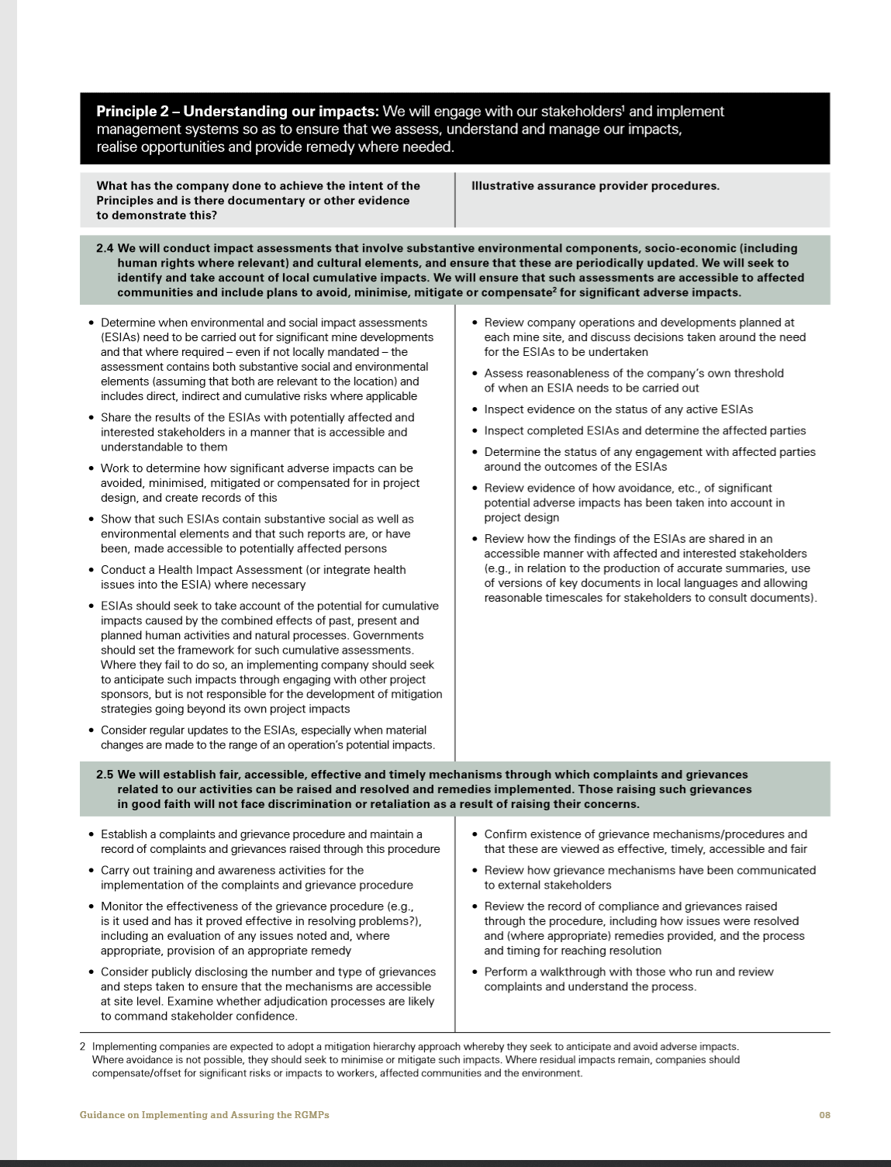
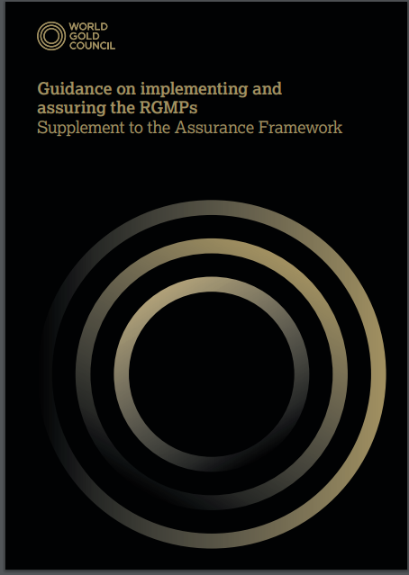
Implementation Guidance
This is a guidance document to support companies’ implementation. The table is intended to be illustrative rather than a mandatory set of compliance criteria.

Slide 31
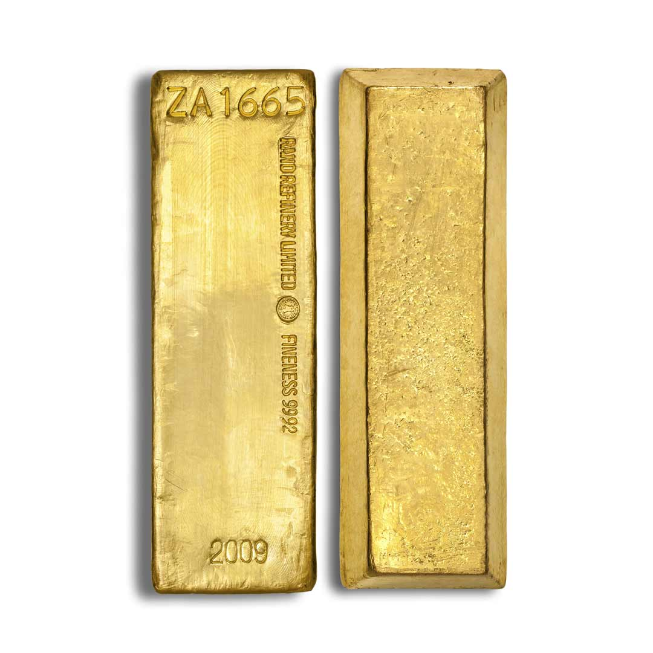
Questions?

Slide 32
Thank you
For more information:
www.gold.org/who-we-are/our-members/responsible-gold
www.gold.org/research/gold-and-climate-change

Slide 33
Disclaimer
Copyright & other rights
            © 2020 World Gold Council. All rights reserved. World Gold Council and the Circle device are trademarks of the World Gold Council or its affiliates. Other third party data and content is the intellectual property of the respective third party and all rights are reserved to them.
            The material contained in this document is provided solely for general information and educational purposes and is not, and should not be construed as, an offer to buy or sell, or as a solicitation of an offer to buy or sell, Gold, any Gold related products or any other products, securities or investments. Nothing in this document should be taken as making any recommendations or providing any investment or other advice with respect to the purchase, sale or other disposition of Gold, any Gold related products or any other products, securities or investments, including without limitation, any advice to the effect that any Gold related transaction is appropriate for any investment objective or financial situation of a prospective investor. A decision to invest in Gold, any Gold related products or any other products, securities or investments should not be made in reliance on any of the statements in this document. Before making any investment decision, prospective investors should seek advice from their financial advisers, take into account their individual financial needs and circumstances and carefully consider the risks associated with such investment decision. World Gold Council and/or a related party may participate as a sponsor of the forum where this information is presented.
            Without limiting any of the foregoing, in no event will the World Gold Council or any of its affiliates be liable for any decision made or action taken in reliance on the information in this document and, in any event, the World Gold Council and its affiliates shall not be liable for any consequential, special, punitive, incidental, indirect or similar damages arising from, related to or connected with this document, even if notified of the possibility of such damages.
            This document contains forward-looking statements. The use of the words “believes,” “expects,” “may,” or “suggests,” or similar terminology, identifies a statement as “forward-looking.” The forward-looking statements included in this document are based on current expectations that involve a number of risks and uncertainties. These forward-looking statements are based on the analysis of World Gold Council of the statistics available to it. Assumptions relating to the forward-looking statement involve judgments with respect to, among other things, future economic, competitive and market conditions all of which are difficult or impossible to predict accurately. In addition, the demand for Gold and the international Gold markets are subject to substantial risks which increase the uncertainty inherent in the forward-looking statements. In light of the significant uncertainties inherent in the forward-looking information included herein, the inclusion of such information should not be regarded as a representation by the World Gold Council that the forward-looking statements will be achieved. The World Gold Council cautions you not to place undue reliance on its forward-looking statements. Except in the normal course of our publication cycle, we do not intend to update or revise any forward-looking statements, whether as a result of new information, future events or otherwise, and we assume no responsibility for updating any forward-looking statements

Slide 34
