Slide 1
Responsible Gold Mining Principles
Implementation and Assurance
Webinar for Assurance Providers
May 17th & 23rd 2022

Slide 2


Agenda
Introduction and context
Overview of the RGMPs
RGMP Implementation
RGMP Assurance
RGMP Reporting
Q+A

Slide 3
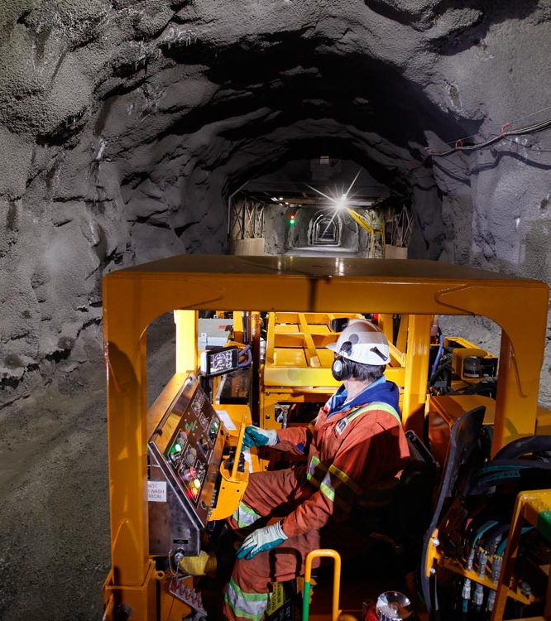
Supporting the
Gold market
SPDR Gold Shares (GLD®)
Launched first Gold-backed ETF in the US in partnership with State Street Global Advisors
    Supporting the gold market
    Leading industry authority on gold for
    over 30 years
    Proven track record for strengthening market infrastructure, delivering robust data and insights and developing solutions to expand access to gold globally
    Deep relationships with the institutional investor ecosystem, central banks, sovereign wealth funds and industry participants
China Market Expansion
Played key role in evolution of the Shanghai Gold Exchange; currently working towards enabling insurance companies to invest in Gold
India Blueprint
Led steering committee comprised of financial institutions and industry and trade associations in the development of a blueprint for a proposed Gold Spot Exchange
Responsible Gold Mining Principles
Worked with mining company members, developed a framework setting out expectations for consumers, investors and the downstream Gold supply chain as to what constitutes responsible Gold mining
Gold Valuation Framework
Developed an academically endorsed methodology to help investors understand how macroeconomic scenarios might impact Gold demand, supply and long-term performance
  Image courtesy of
Newmont
Data
Analytics
Research
Market
knowledge
Policies
Infrastructure

Slide 4






























World Gold Council members
31 companies; 500+ projects; 100+ productive mines; operations in 45+ countries

Slide 5
The intent behind the RGMPs
An organising framework for ESG issues in the gold mining sector
Recognises and builds on established international conventions and best practices
Principle-based, with guidance on what implementation can look like
Discharges ESG obligations to refiners and other downstream companies
Helps avoid duplication and excessive audit burden
Drives ESG performance improvements at a site level
Ultimately, the intent is to enhance marketplace and stakeholder confidence in both the product and the production process (i.e. gold and gold mining).

Slide 6
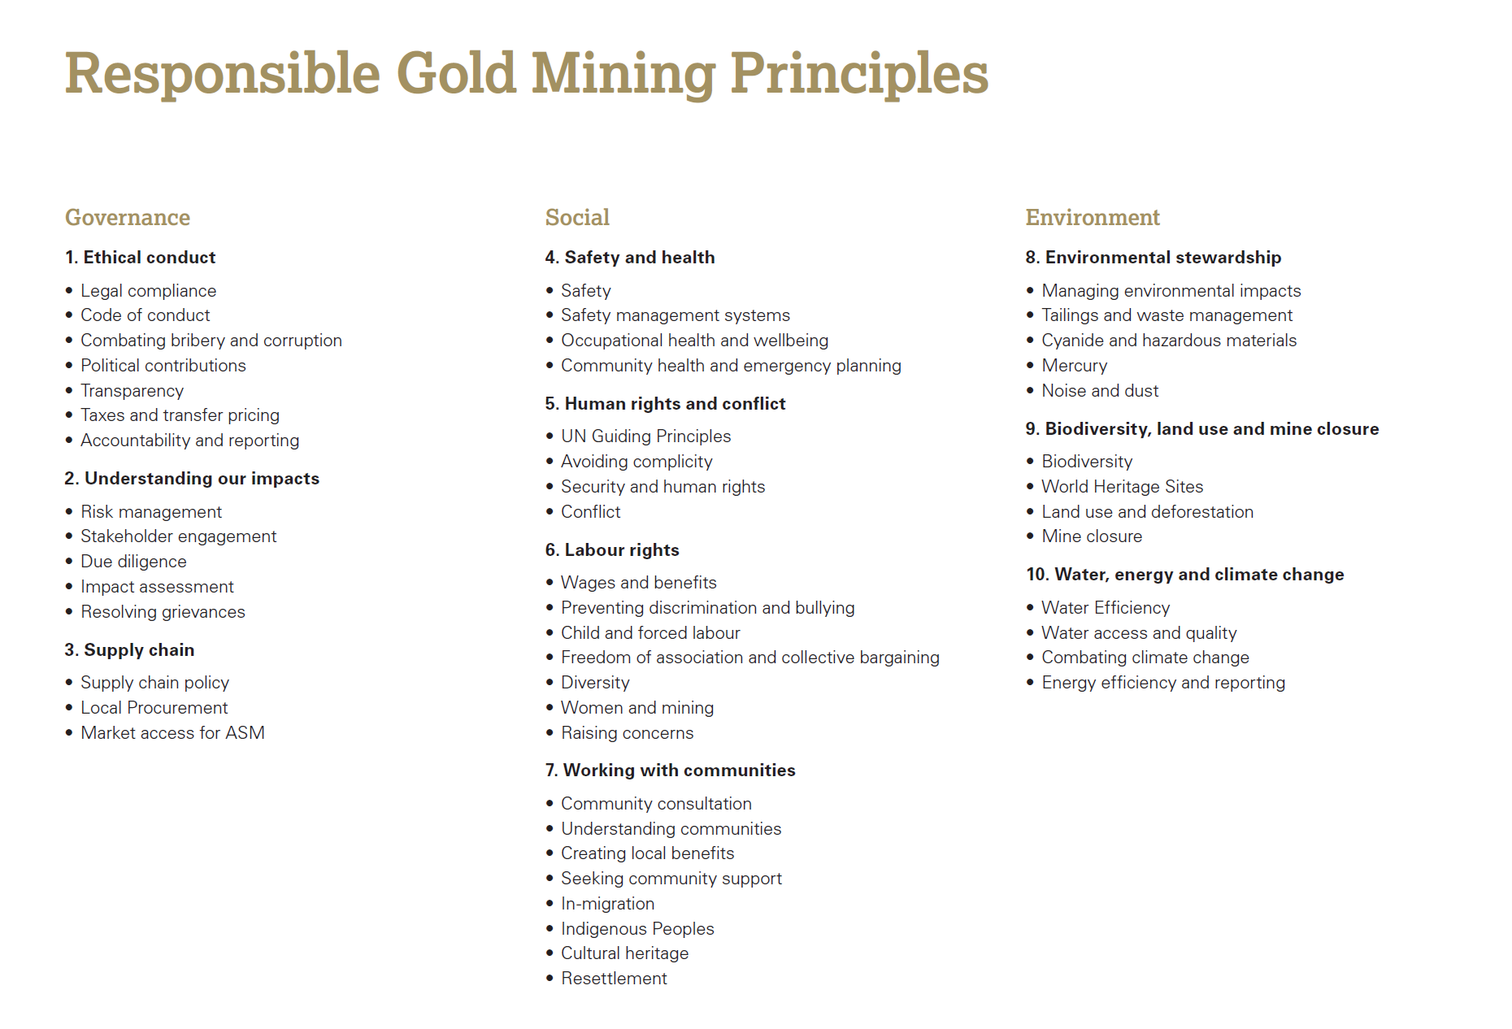

51 operational Principles, under 10 Umbrella Principles

Slide 7



RGMP supporting documents

Slide 8
RGMP Implementation: Timelines
RGMP Launch
September 2019
Year 1 & 2
Require updates on progress towards conformance.
Deadlines for meeting year 1 & 2 requirements: September 2020 and 2021 respectively
Year 2 assurance and disclosure deadline: 31 March 2022
Year 3
Deadline for full conformance: 30 September 2022
Deadline for year-3 assurance and disclosure requirements: 30 June 2023
New Members
Companies joining the WGC after Sept 2019 will have three years from the date of joining to conform with the RGMPs, and an additional nine months to meet the disclosure and assurance requirements.

Slide 9
RGMP Implementation: Scope
    In scope:
    RGMPs are applicable at all operating sites where the principal output is gold
    Conformance with all 51 RGMPs is required unless any are deemed “not applicable” (see next slide)
    Out of scope:
    Non-operating sites such as exploration/development projects, care & maintenance/closed sites
    Non-gold producing sites (e.g., copper assets)
    Minority-held JVs or where the company does not have operational control
    Additional non-mandatory application of the RGMPs (not subject to assurance):
    Companies are encouraged to apply RGMPs at non-operational sites where relevant
      For example, 2.2 Stakeholder engagement, 2.4 Impact management
      Early implementation of the RGMPs is important to ensure conformance once sites are operational
    Companies are encouraged to apply RGMPs, where relevant, at operating sites producing other metals
    Companies are expected to use their influence to encourage adoption of the RGMPs at companies or sites in which they are invested but do not exercise operational control (applies to royalty and streaming companies)

Slide 10
RGMP Implementation: Applicability
    Most RGMPs are applicable at the site level or site and corporate level
    A few RGMPs are applicable at the corporate level only
    e.g., 1.5 Transparency, 1.7 Accountabilities and reporting
Certain RGMPs may be “not applicable” at individual sites depending on local context
    Examples:
    7.5 In-migration – if the site is isolated, and in-migration doesn’t occur
    7.6 Indigenous Peoples – if there are no Indigenous Peoples near the site
    7.8 Resettlement – if there is no resettlement planned or required
A sub-component of a Principle may also be “not applicable”
    10.1 Water Efficiency – “When we operate in water-stressed areas…”
For any RGMPs deemed “not applicable” the reasons should be provided and reviewed by the assurance provider and disclosed if necessary

Slide 11
RGMP Implementation: Materiality
    A materiality lens can be applied to the implementation and assurance of the RGMPs
    Based on the risks, complexity and/or potential impact associated with an RGMP
    Enables implementation to be tailored to local conditions and circumstances
    This would only influence how an RGMP is implemented in practice, not if the RGMP is implemented
    Examples of how the materiality of an RGMP could be different in different contexts:
5.3 Security and human rights - a site in a developing country with weak governance/rule of law vs developed country/strong rule of law
6.3 Child and forced labour - countries with a history of child/forced labour vs countries where strong labour rights are entrenched in law
7.1- 7.4 Working with communities - a site near heavily populated communities vs a site in an isolated and remote area
    RGMP conformance is binary (i.e., pass or fail), but where there is no clear “bright line” criteria for conformance:
    Focus of the implementation should be on the processes and systems which reflect the intent of the Principles
    Companies need to demonstrate progress (even if in the early stages) and indications of continuous improvement
    WGC Guidance should be used for examples of ways in which conformance can be demonstrated
    Ultimately, the assurance providers will need to use their professional judgement, and the guidance provided by the WGC, to determine whether a company is in conformance with the intent of the RGMPs.

Slide 12
RGMP Assurance: Overview
Conformance is a WGC membership requirement (but implementation is not exclusive to members)
The Assurance Framework was developed to provide a credible, practical process for application across different operating contexts
Site visits are critical to the assurance process
Conformance is determined for the company as a whole
Focus is on the systems in place and how the Principles are being put into practice (not just assuring the contents of a Sustainability or RGMP Report)
Assurance is on the Principles, specific wording of each is important;
WGC provides guidance, but decisions on company conformance rests with the assurance providers

Slide 13
RGMP Assurance: Standards & Criteria
Required credentials of assurance providers
  Independent
  Competent, expert in the subject matter
  Must use a globally recognised assurance standard (e.g. ISAE3000)
  Other considerations
  Assurance requires a multidisciplinary team (e.g. 2-3 experts)
  Mining experience is critical
  Support and guidance to assurance providers is provided by the WGC
  Limited level of assurance expected

Slide 14
RGMP Assurance: Site visits
Site visits are used to ensure Principles are applied in practice on the ground
Depending on the size of the company and its portfolio, 1 to 4 sites should be visited per year as part of the assurance process
Aim is to cycle through all sites in 3-5 years (higher risk sites should be visited in the early years)
Site prioritisation: Companies and assurance providers should use a risk and materiality assessment to determine which sites should be visited first
Selective external consultations at a site may be including as part of the assurance process
If necessary, “remote testing” could be conducted using desk reviews, conference calls and/or virtual visits to address any significant issues at non-visited sites.

Slide 15
RGMP Assurance: Procedures
The assurance procedures and evidence-gathering activities are likely to include:
Assessment of whether operations included in the RGMPs are consistent with defined reporting boundaries
Review of the company’s self-assessment of conformance with the Principles at its operations
Review of whether the company’s application is in line with the intention or spirit of the Principles
Review of whether or not internal systems and processes related to the Principles are in place (as per examples in Guidance on implementing and assuring the RGMPs: supplement to the Assurance Framework) and whether associated performance at site level reflects conformance
Evidence-gathering activities to review how the requirements of the Principles have been implemented in practice; these activities are likely to include the following requirements:
    Site visits
    Management interviews
    Review of risk assessments
    Review of systems and processes relevant to the Principles
    Evaluation of other audit and assurance processes/controls
    Testing of internal controls for prevention and detection of material errors
    Sample testing the integrity of underlying information.
    Consultation with external local stakeholders may be included, but is not mandatory

Slide 16
RGMP Assurance: Equivalency
Other Relevant International Standards
ICMM Mining Principles
International Cyanide Management Code
ISO 14001, 45001, etc.
International Finance Corporation (IFC) Performance Standards
Voluntary Principle on Security and Human Rights
Human Rights Due Diligence (against the UN Guiding Principles)
Mining Association of Canada’s Towards Sustainable Mining (MAC-TSM) Protocols
World Gold Council’s Conflict-Free Gold Standard (CFGS)
Using existing audits and external assurances
  Companies may have completed separate audits, assurances against other credible standards, either at the corporate level or at specific sites
  Assurance providers should rely on other audits to the greatest extent possible in order to avoid duplication and audit fatigue
  The assurance providers will need to satisfy themselves that the scope and quality of the other assurance is on par with their standards
  Equivalency benchmarks
  WGC had agreed equivalency standards with ICMM’s Mining Principles and Mining Association of Canada’s TSM
  See https://www.gold.org/industry-standards/responsible-gold-mining
  Assurance over multiple frameworks
  Companies are encouraged to use the same assurance provider to assure against multiple frameworks with overlapping requirements where possible

Slide 17
RGMP Assurance: Non-conformance
  From year 3, the company must disclose any non-conformances, including incidents, in a transparent, fair and balanced manner.
  Non-conformances will be referenced by the assurance provider in their conclusion.
  Assurance provider will use their judgement to decide whether they can still deliver a statement of assurance if non-conformances exist
  Adequate action plans and commitment to timely conformance for non-material RGMPs may not result in overall non-conformance.
Potential reasons for a company’s non-conformance:
A site is out of conformance with the RGMPs, and no remedial action plan is in place
An excessive number of RGMPs are out of conformance even if actions plans are in place
A site has an incident which suggests they have fallen out of conformance with the RGMPs since the last assurance review

Slide 18
RGMP Reporting: Guidance
  Annual disclosure on RGMP progress required
  Two reports are required annually:
    RGMP Report produced to report on progress by the implementing company (could be integrated into Sustainability Report)
    Independent Assurance Report produced by the assurance provider
  Basic reporting templates included in the Assurance Framework Guide

Slide 19

Assurance and Reporting:
Summary
  Companies are expected to meet all 51 RGMPs by Sept 2022 and complete the related disclosure and assurance by June 2023
  Assurance Framework designed to be a credible, practical guide to conducting assurance
  Intent is to drive ESG performance improvements and ensure confidence across the gold sector

Slide 20
Responsible Gold Mining Principles
Implementation and Assurance
Webinar for Assurance Providers
May 17th & 23rd 2022

